Slide 1

Department of Physics and Astrophysics University of Delhi SIGN LANGUAGE RECOGNITION USING PYTHON
BY: GROUP- 2 (BARDEEN)
DEEPANSHU SHARMA (20025762016)
DIPIKA SHARMA (20025762019)
JAYTE PRAKASH KURIL (20025762026)
KANIKA KARDAM (20025762028)
KESHAV SHARMA (20025762031)
NEHA (20025762037)

Slide 2
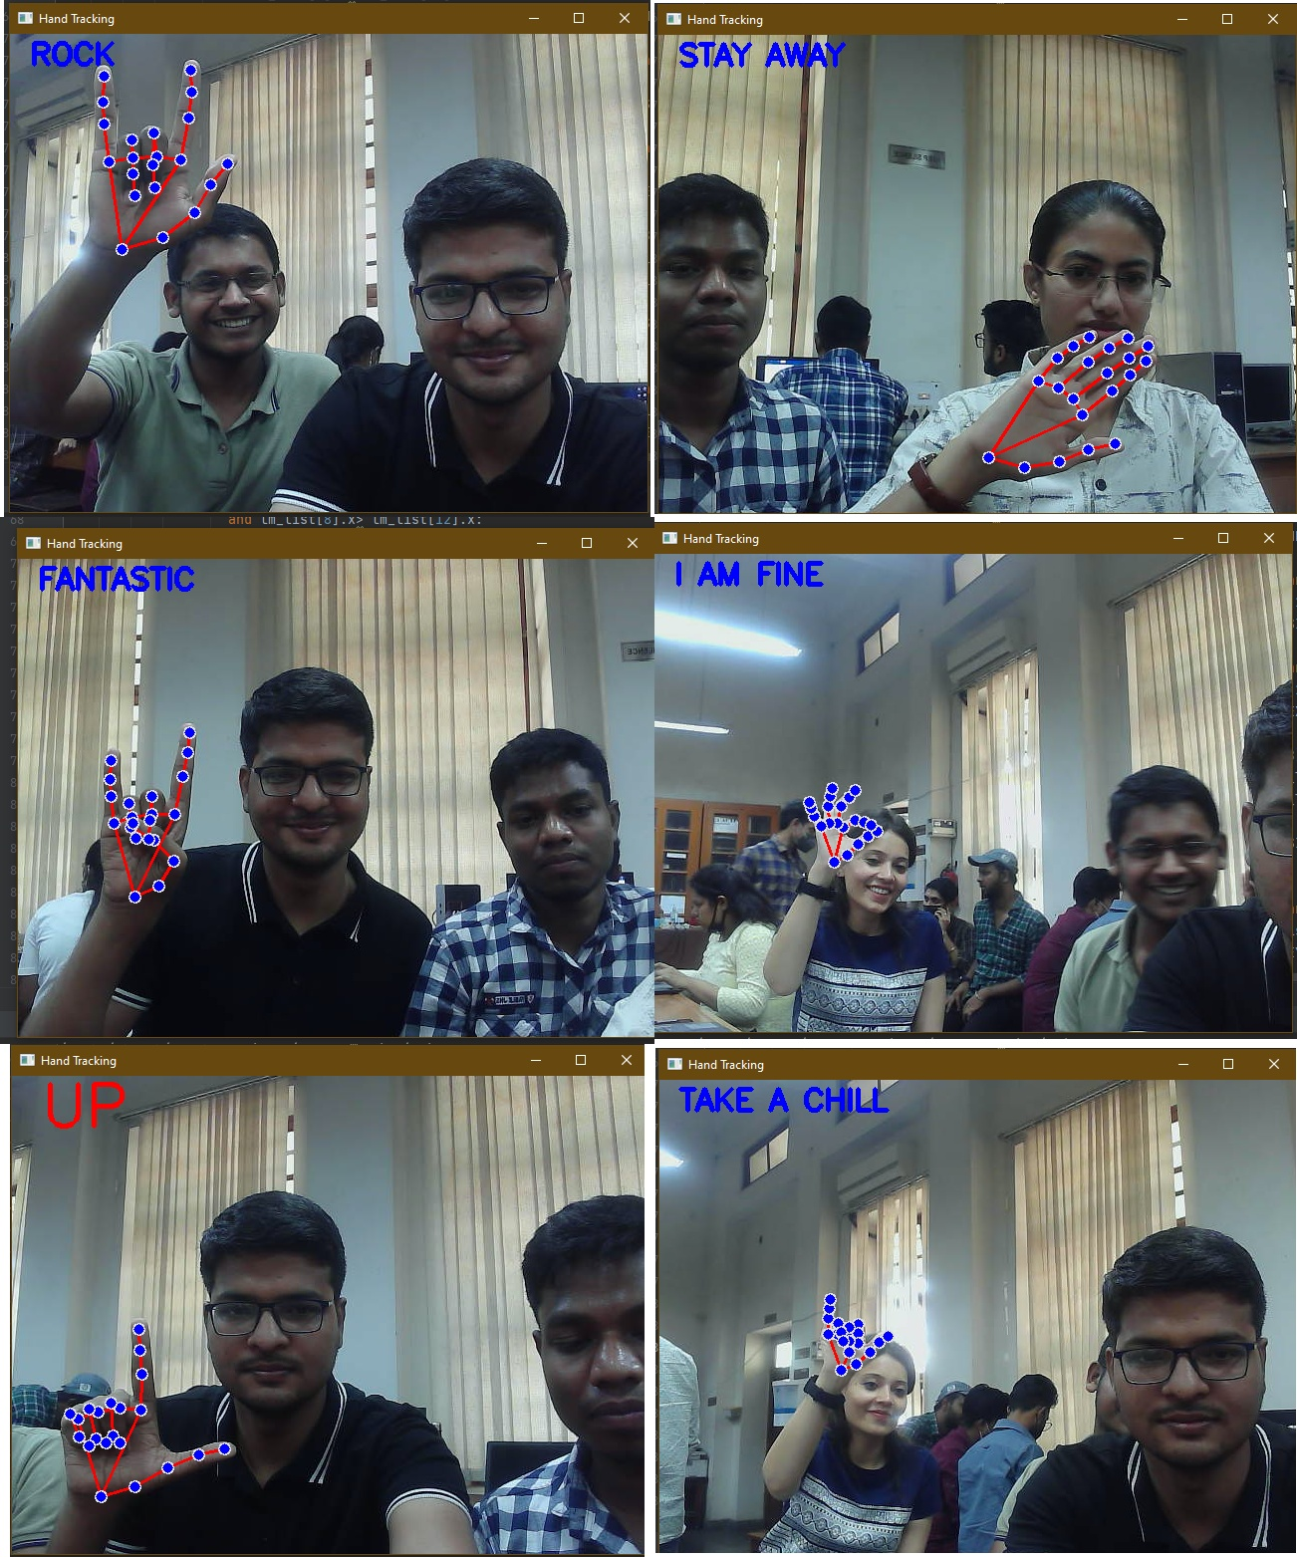
A glimpse of the project

Slide 3
INTRODUCTION
The aim of the project is to convert sign language to text and audio to be easily recognised by deaf and dumb people using hand gesture recognition.
The goal is to make computers to understand human language and develop a user-friendly human computer interface.
Gesture analysis is a scientific field that can recognise gestures such as hand, arm, head, and even structural motions that usually entail a certain posture and/or motion.
Our aim was to apply computer-vision ideas to the real-time processing of gesture outputs. It concentrates on gesture recognition in the open CV framework using the Python language.

Slide 4
APPROACHES USED
We have tried here two different approaches to achieve the same.
1. Using machine learning by recognising hand landmarks.
2. Using Tensorflow.

Slide 5
APPROACH-1
In the first approach we have tried to convert sign language to text and audio by using hand landmarks.
Our hand could be defined in some set of coordinate points which is similar to the coordinates we have in general i.e the points could be defined in some set of x and y values.
So by hand landmarks here we are assigning different coordinate values for different sign ,detecting them and then further converting the obtained text to audio.

Slide 6
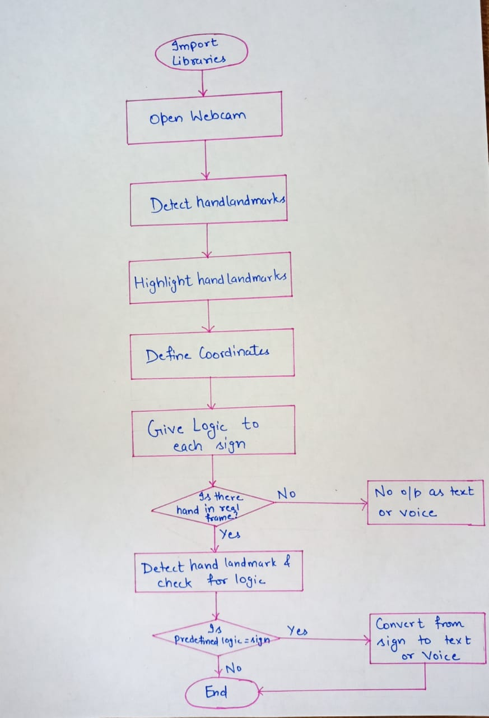
Flowchart for approach-1

Slide 7
Libraries

Slide 8
Open CV
Open Source Computer Vision.
Developed to escalate the use of machine learning perception in commercial products.
It has licensed of BSD (Berkeley Software Distribution )
Has more than 2500 optimized algorithms providing broad applications to Open CV.

Slide 9
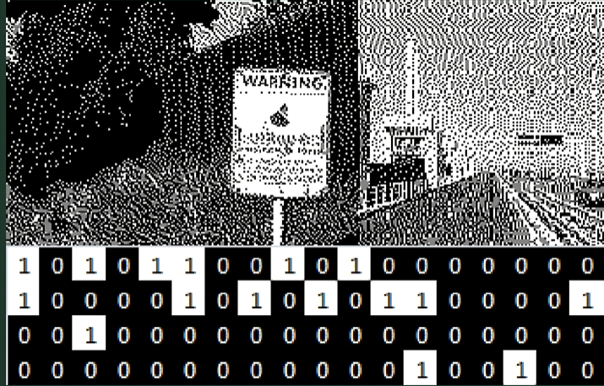
How it works?
Images are represented by rows and columns and determined by pixels.
Binary numbers assigned to bits in images are like:

Slide 10
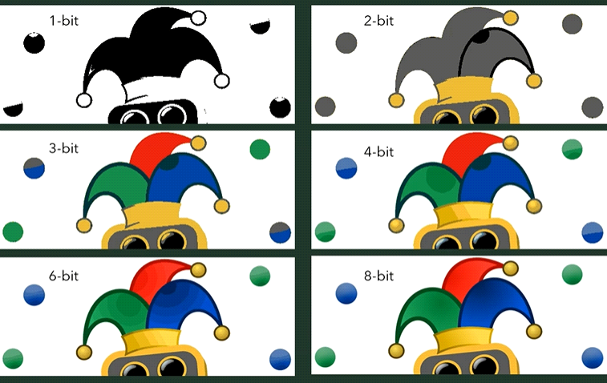
1- bit means it has (2¹)=2 colors.
2-bit means it has (2²)=4 colors and n-bit means it has (2^{n}) colors.
Various combinations of 8-bit represents different colors like:
00000000 BLACK
00000001 BLACK WITH LESS DARKNESS
…
…
11111111 WHITE

Slide 11
Various Uses of Algorithms
Facial Recognition
Identification of objects
Object Recognition
Image Processing
Gesture Recognition
Finding similar images from an image database
And many more…

Slide 12
MediaPipe
Mediapipe is a cross-platform library developed by Google that provides amazing ready-to-use ML solutions for media processing.
Machine Learning solutions are a complete set of intellectual property, tools and software for AI development across a vast array of devices

Slide 13
What is possible with MediaPipe?
There are a number of AI problems that can be done by MediaPipe.
Here some are mentioned:
Live Hand Tracking
II. Box Tracking
III. Face Mesh
IV. Hair Segmentation
V. Object Tracking and many more

Slide 14
Real-Time Hand Tracking Project
It employs machine learning (ML) to identify 21 3-D landmarks of a hand from just a single frame.
It utilizes an ML pipeline consisting of two models working together:
A palm detector model
A hand landmark model

Slide 15
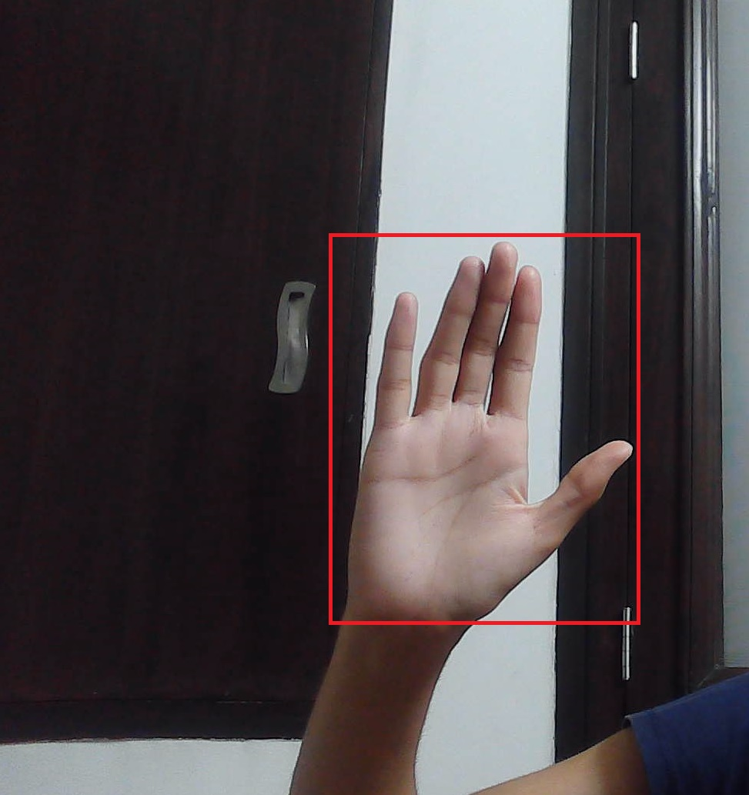
A palm detector model
A palm detector model operates on the full image and returns an oriented hand bounding box.
Using Palm Detection Model, we achieve an average precision of 95.7% in palm detection

Slide 16
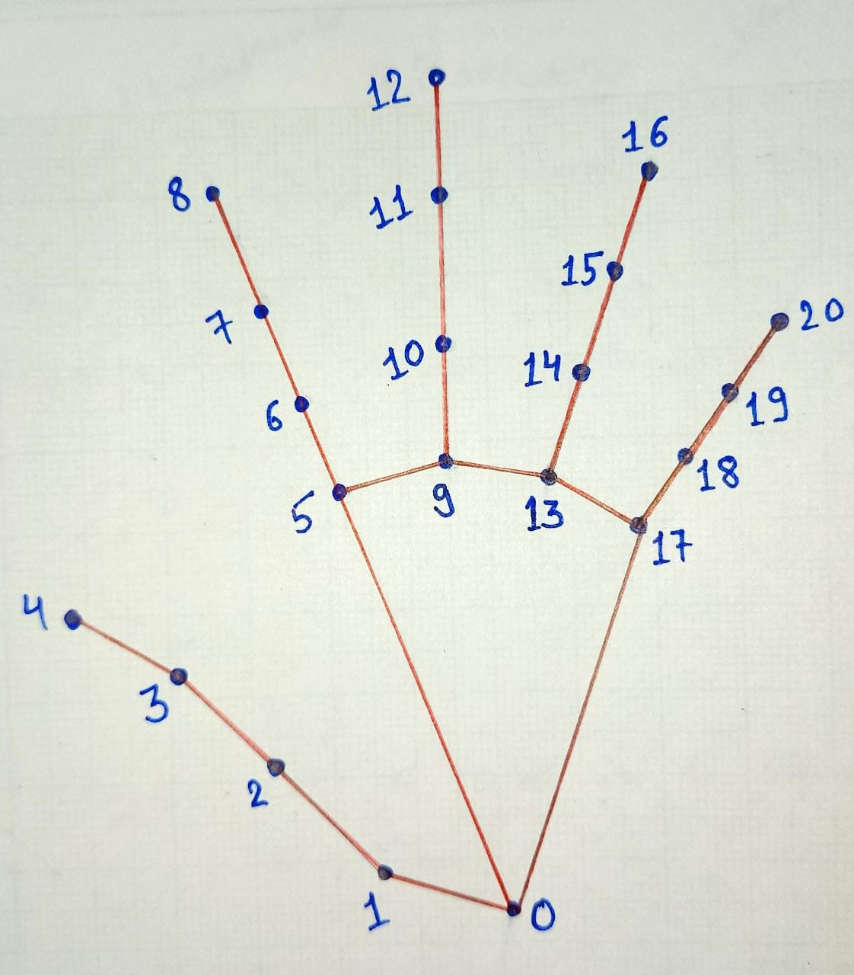
A hand landmark model
It returns high fidelity 21 3-D hand key points via regression that is direct coordinate prediction.

Slide 17
Playsound
It is a Cross platform module that can play audio files in Windows, Mac, Linux.
Doesn’t have any dependencies.
Works for both .wav and .mp3 format audios.
Requirement: The audio file should be in the same directory as of python program, unless path of audio has to be specified.

Slide 18
How to use?
Step 1: Import playsound module.
Step 2: Using module and defining path.

Slide 19
OUTLINE OF 1st approach
We will have to take given steps for detection of sign language.
1 - Import Libraries
2 - Opening Webcam
3 - Detecting Hand Landmarks
4 - Highlighting Hand Landmarks
5 - Coordinate Defining
6 - Logic Defining
7 - Playing Sound

Slide 20
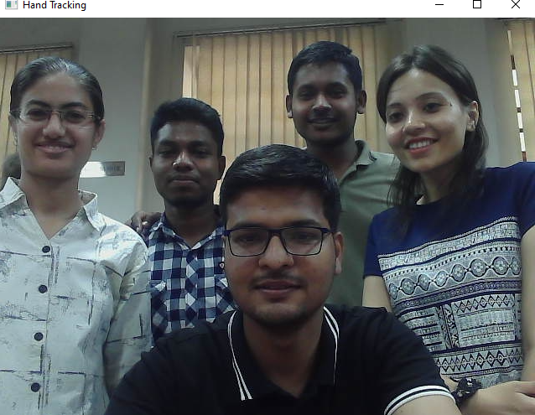
Step 2 : Open Webcam
This enables to get live frame in which we are recognizing various signs. Only After coding for opening of webcam, we are able to further image processing to identify signs.
import cv2 # Import Open CV
cap = cv2.VideoCapture(0) # 0 for primary camera
while True:
ret,img = cap.read() # For reading all the captured frames
cv2.imshow("Hand Tracking",img) # For showing the images
cv2.waitKey(1) # Wait for 1 second

Slide 21
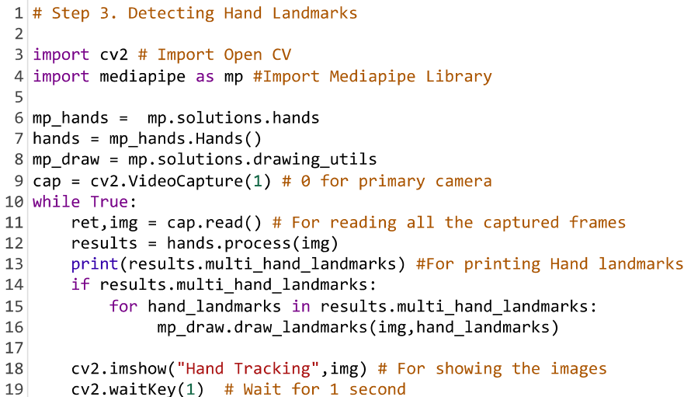
Step 3: Detecting Hand Land Marks:
In this step we are marking 21 3-D hand landmarks. This step enables to identify hand from rest of frame.

Slide 22
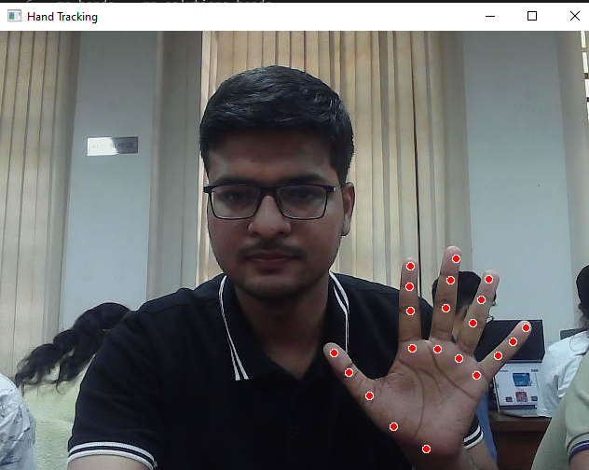
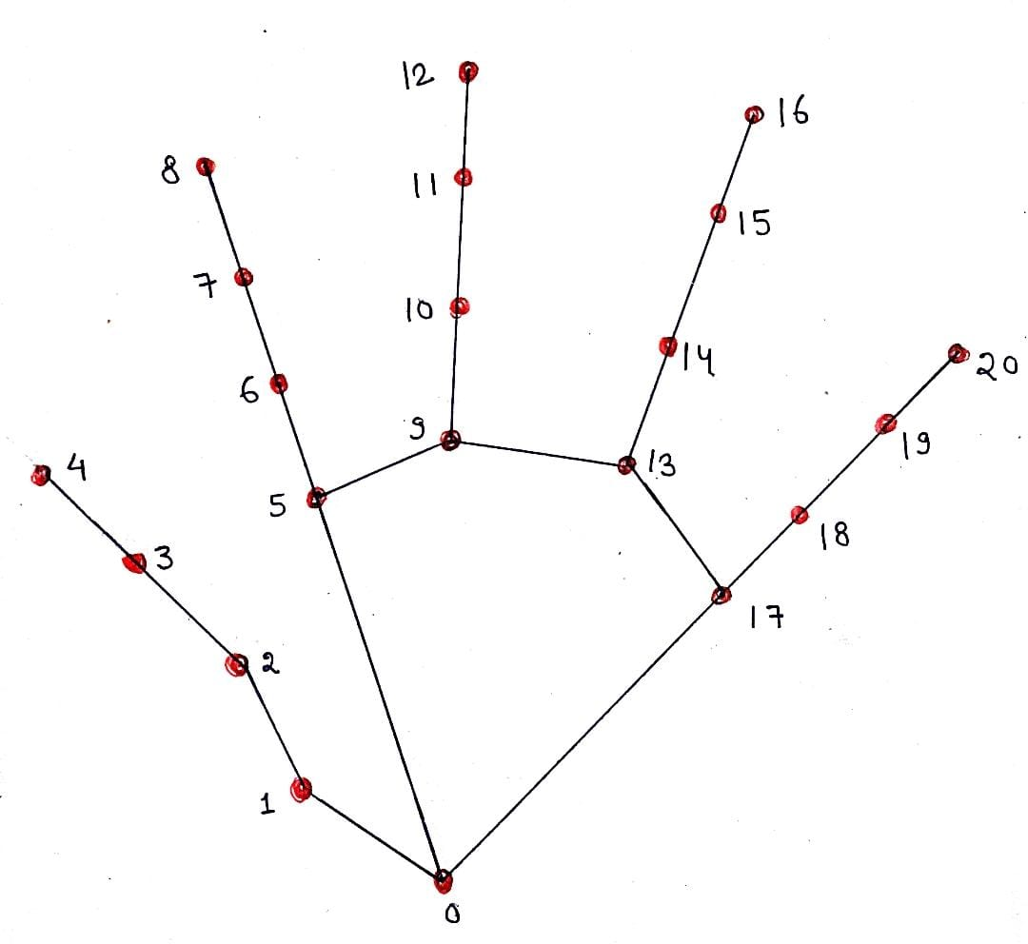

Slide 23
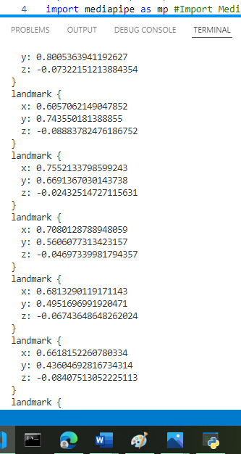
0 WRIST 11 MIDDLE FINGER DIP
1 THUMB CMC 12 MIDDLE FINGER TIP
2 THUMB MCP 13 RING FINGER MCP
3 THUMB IP 14 RING FINGER PIP
4 THUMB TIP 15 RING FINGER DIP
5 INDEX FINGER MCP 16 RING FINGER TIP
6 INDEX FINGER PIP 17 PINKY MCP
7 INDEX FINGER DIP 18 PINKY PIP
8 INDEX FINGER TIP 19 PINKY DIP
9 MIDDLE FINGER MCP 20 PINKY TIP
10 MIDDLE FINGER PIP

Slide 24
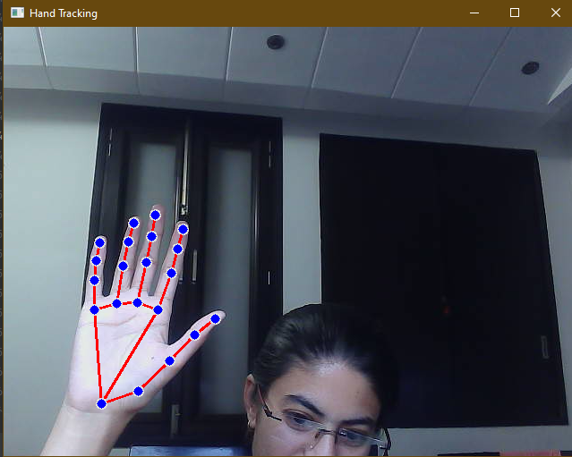
Step 4: Highlighting Hand Landmarks:
Here we highlight each landmark with a circle of defined radius and all landmarks are connected with straight lines, looking like a bone like structure of hand.

Slide 25
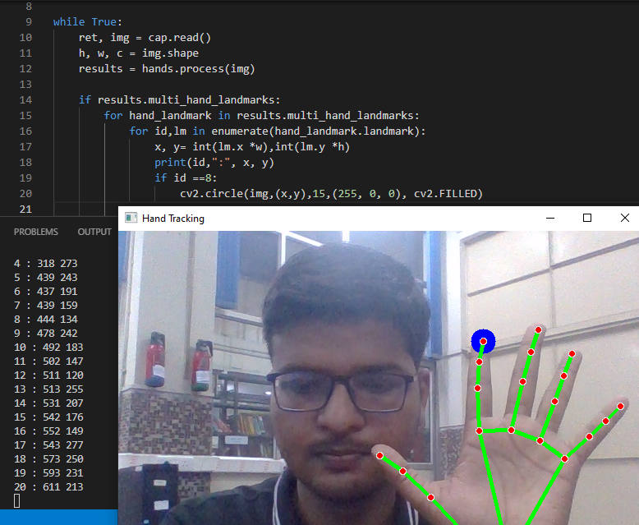
Step 5 : Coordinates defining:
In this step we define coordinate of each landmark by multiplying with width and height. This step enables us to apply some logic on landmarks to define a sign.

Slide 26
Step 6: Logic defining:
Here we give certain conditions to landmarks so that in real time frame, satisfying the conditions on landmarks, it displays that signs on frame itself.
FOR LIKE SIGN
For like sign I can see here that y co-ordinate of thumb TIP (4th landmark) Should be greater then Thumb IP (3rd landmark) And Thumb IP(3rd landmark) will be greater then Thumb MCP (2nd landmark).
But In our programme we have used flip function in 22 line which is rotating images by 180 degrees. So Here we will have to use Y(Thumb tip) or (4^{th point}) < Y (Thumb tip -1) or (3rd point) < Y (thumb tip -2) or (2nd point) or we can also

Slide 27
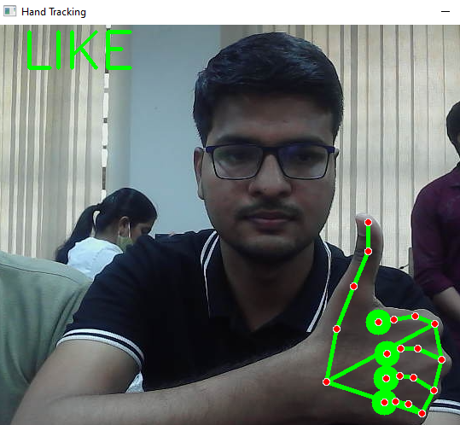
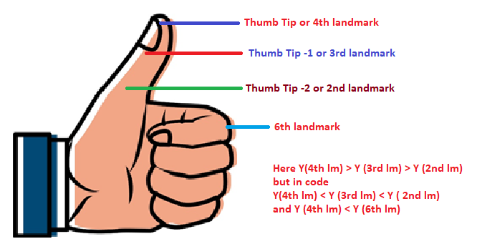
see in figure that ln figure that Y (Thumb tip ) or Y(4th landmark ) < Y (Index finger PIP) or Y (6th landmark).

Slide 28
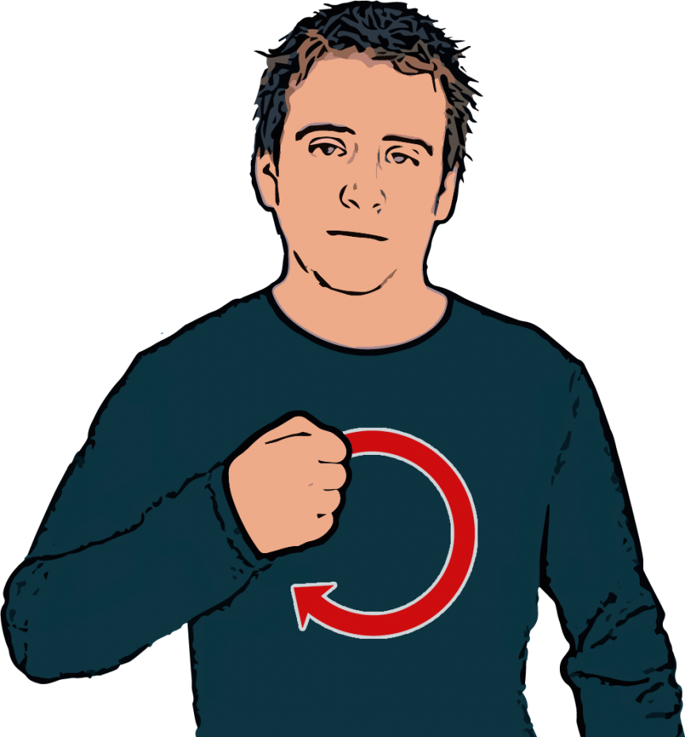
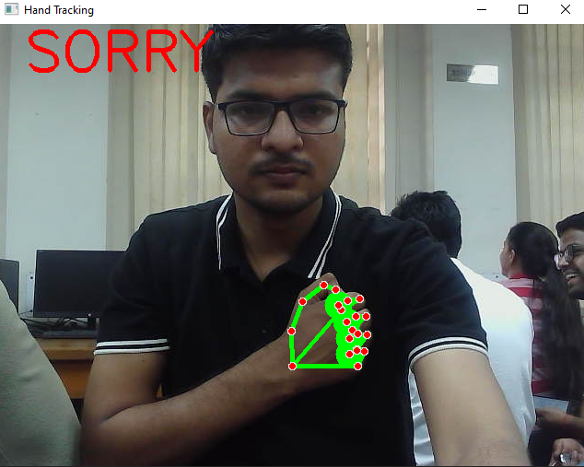
Sorry In Indian /American Sign Language

Slide 29
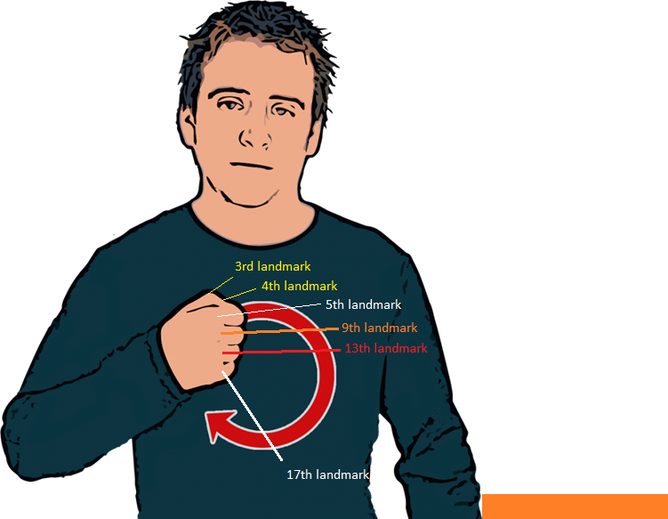
LOGIC FOR SORRY
Y (3rd landmark) > Y (4th landmark)
Y (5th landmark) > Y (9th landmark)
Y (9th landmark) >Y (13th landmark)
Y (13rd landmark) >Y (17th landmark)
But In the code we are flipping the image so
In our code we will write
Y(3rd landmark) < Y (4th landmark)
Y (5th landmark) < Y (9th landmark)
Y (9th landmark) < Y 13th landmark)
Y (13rd landmark) < Y (17th landmark)

Slide 30
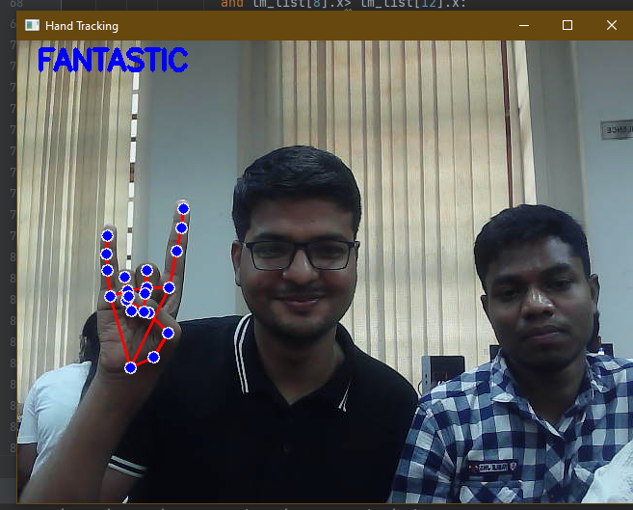
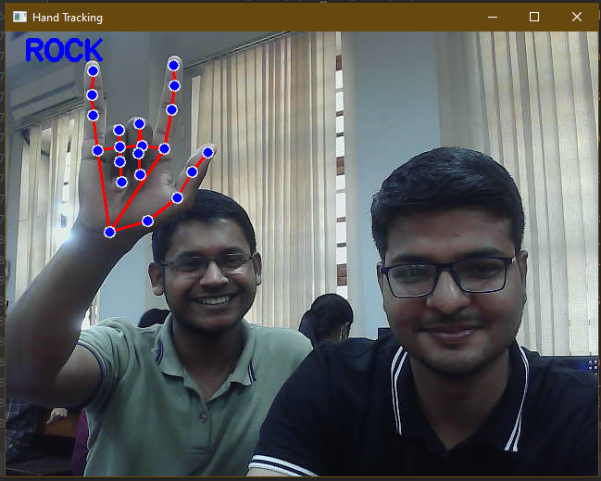
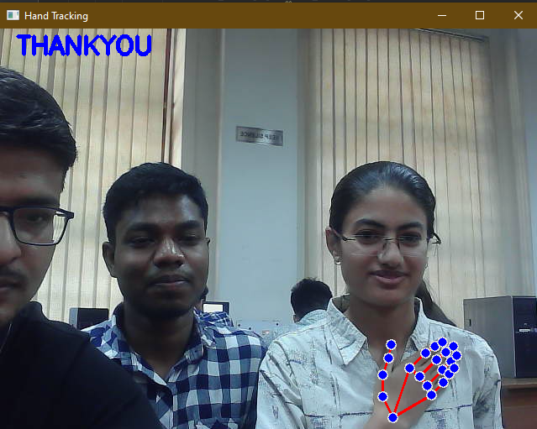
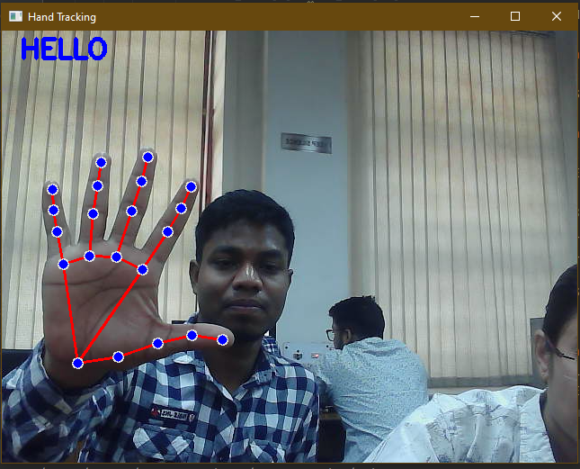
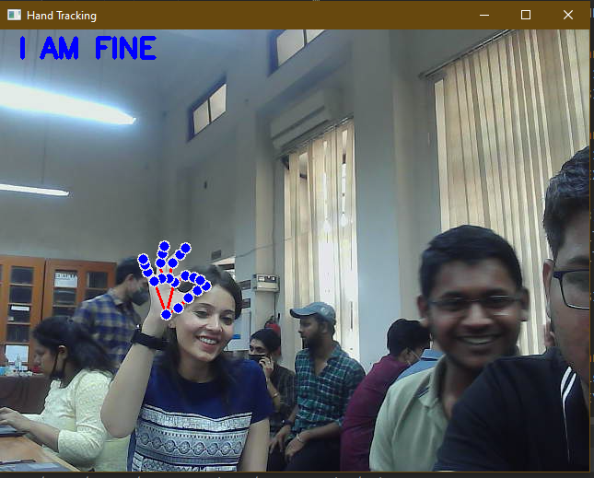
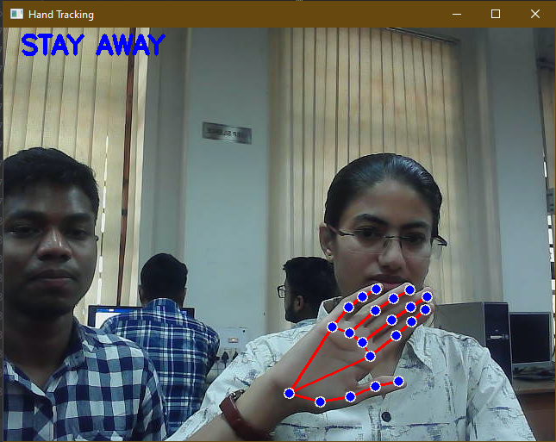

Slide 31
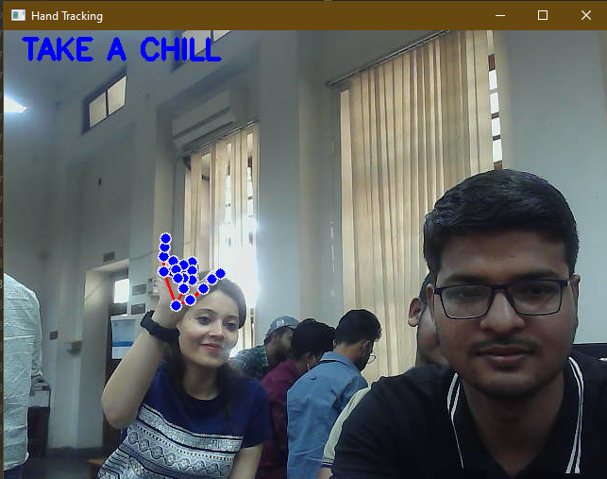
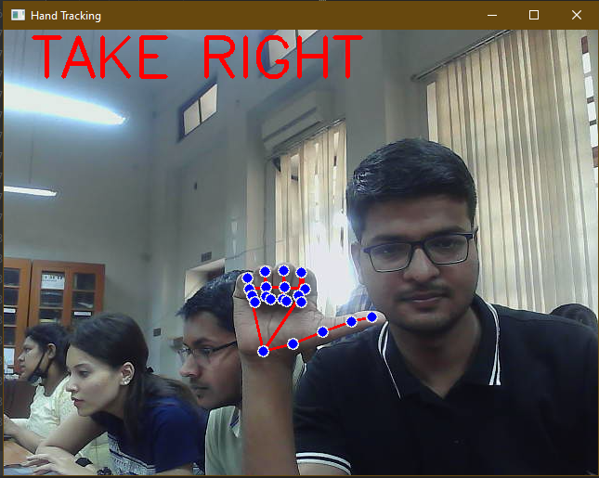
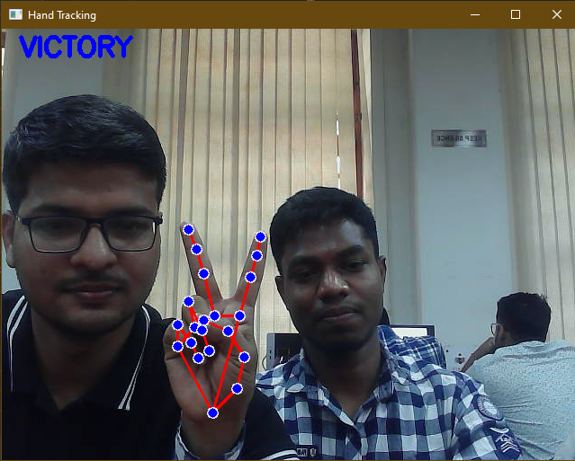
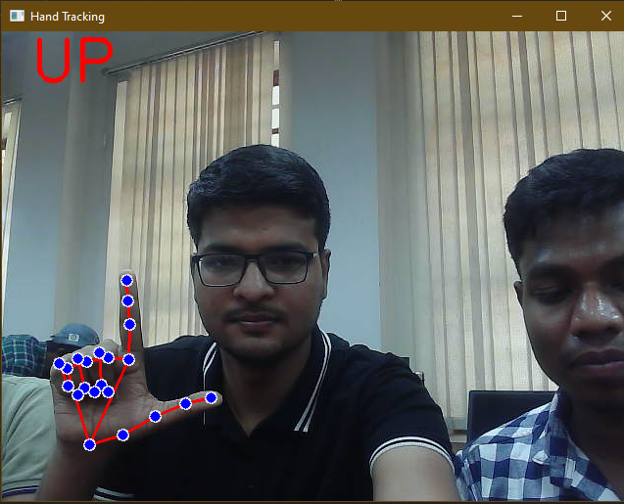
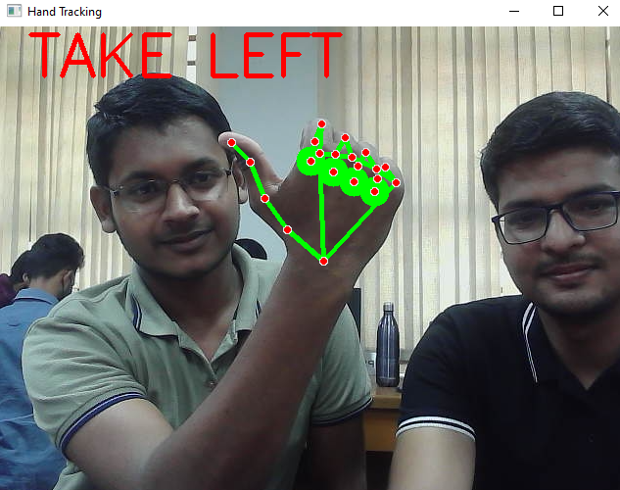
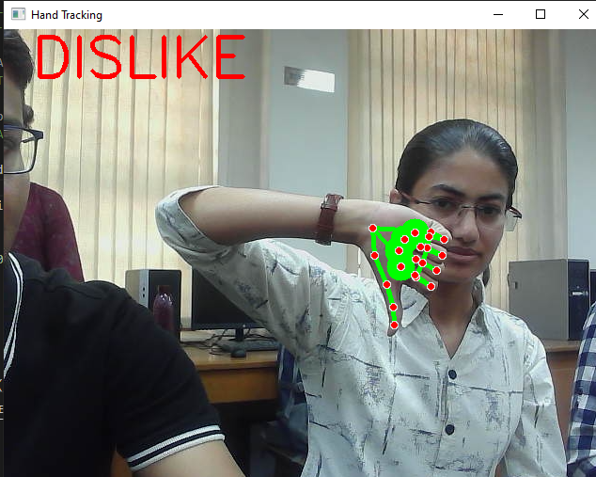

Slide 32
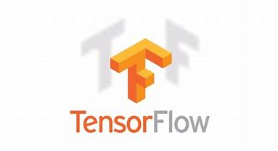
Tensorflow:
TensorFlow is a free and open-source software library for dataflow and differentiable programming across a range of tasks.
It is a symbolic math library, and is also used for machine learning applications such as neural networks.
It is used for both research and production at Google.
Example: Google users can experience a faster and more refined search experience with AI. If the user types a keyword in the search bar, Google provides a recommendation about what could be the next word.
Google wants to use machine learning to take advantage of their massive datasets to give users the best experience. Three different groups use machine learning:

Slide 33
1).Researcher
2).Data Scientists
3).Programmers
They can all use the same toolset to collaborate with each other and improve their efficiency.
Google does not just have any data; they have the world’s most massive computer, so Tensor Flow was built to scale. TensorFlow is a library developed by the Google Brain Team to accelerate machine learning and deep neural network research.

Slide 34
Why use Tensorflow?
It is an open source artificial intelligence library, using data flow graphs to build models. It allows developers to create large-scale neural networks with many layers. TensorFlow is mainly used for: Classification,Perception, Understanding, Discovering, Prediction and Creation.
Main Use Cases of Tensorflow:
1).Text Based Application
2).Image Recognition
3).Time Series
4).Video Detection

Slide 35
Installation:
Install Tensorflow(Linux,Mac OS and Windows)
1. Download Anaconda
2. Create an environment with all must-have libraries.
3. $ conda create tensorflow python=3.8
4. $ activate tensorflow.
5. $ conda install pandasmatplotlib jupyter notebook
6. $ pip install tensorflow

Slide 36
Features of Tensorflow:
1).Open-source Library
2).Easy to run
3).Abstraction
4).Flexibility
5).Effective

Slide 37
APPROACH --2
>> Approach 2 is to recognize the sign language using tensorflow object detection API.
>> We get access to our webcam with the help of OpenCV and python coding and then leads to label them using Labelling Image Package.

Slide 38
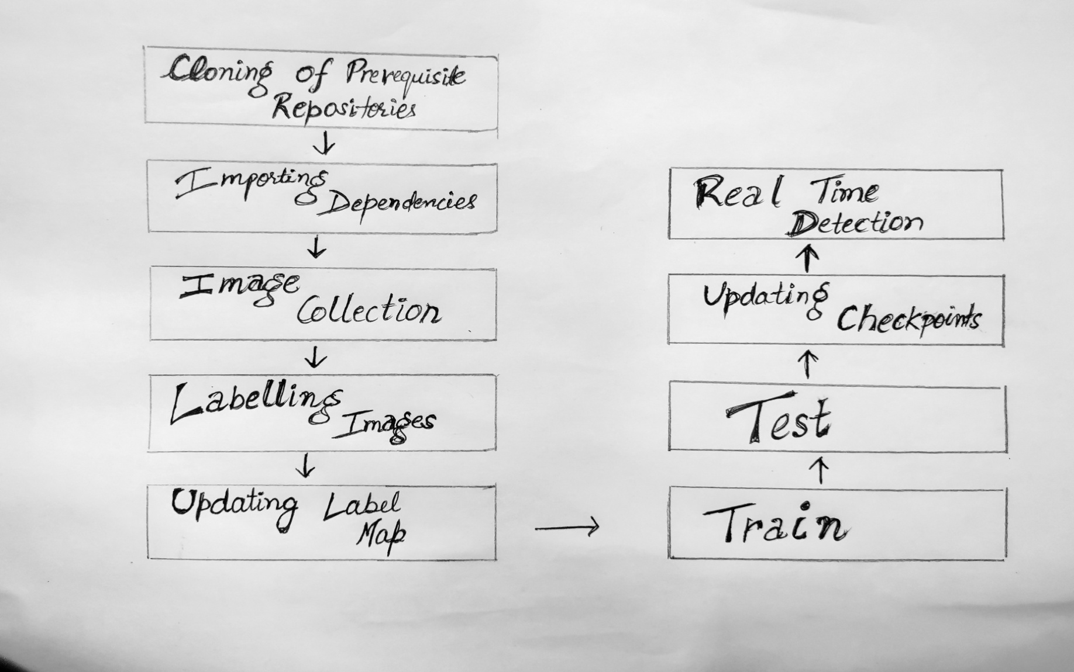
Flow chart for Approach 2

Slide 39
Cloning of Repository
Cloning of RealTimeOBjectDetection repository will provide us leverage to all that transfer learning and pre-processing and training code inside it.
Open your command prompt and type the link (https://github.com/nick nochnack/RealTimeObjectDetection) with git clone command .

Slide 40
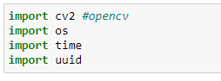
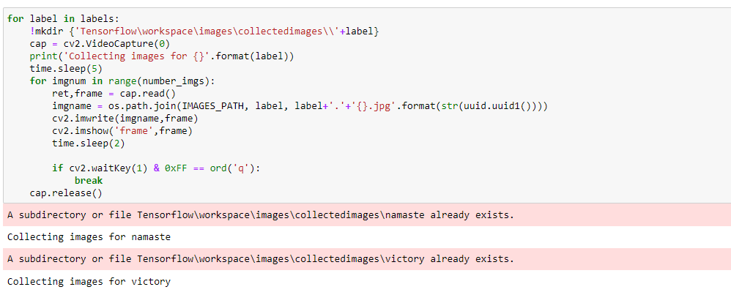
Importing Dependencies and Image Collection

Slide 41
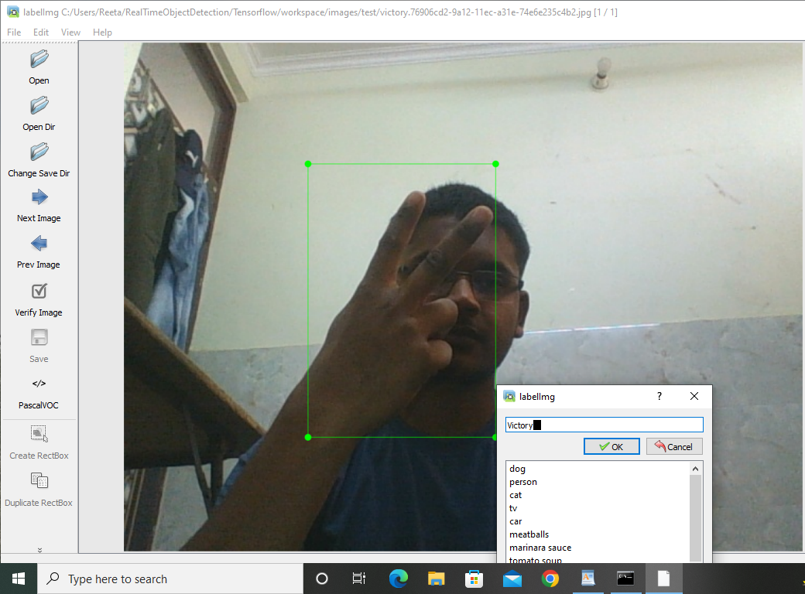
Labelling Images
open command prompt and command python labelimg.py
It leads to an opening to interface for labelling images.

Slide 42
Updating Label Map
By using the reposited code we can update our label map and generate tf_record for transfer learning using the following basic code:-
To generate tf records we need to write code as
!python {SCRIPTS_PATH + '/generate_tfrecord.py'} -x {IMAGE_PATH + '/train'} -l {ANNOTATION_PATH + '/label_map.pbtxt'} -o {ANNOTATION_PATH + '/train.record'}
!python {SCRIPTS_PATH + '/generate_tfrecord.py'} -x{IMAGE_PATH + '/test'} -l {ANNOTATION_PATH + '/label_map.pbtxt'} -o {ANNOTATION_PATH + '/test.record'}

Slide 43
Training
For training part we need to run the code(pythonTensorflow/models/research/object_detection/model_main_tf2.py --model_dir=Tensorflow/workspace/models/my_ssd_mobnet --pipeline_config_path=Tensorflow/workspace/models/my_ssd_mobnet/pipeline.config --num_train_steps=10000) in command prompt.
But we are facing looping of errors.
We got two different attribute errors :’contrib’ and ‘slim’.
Resolution of one error leads to the other error.

Slide 44
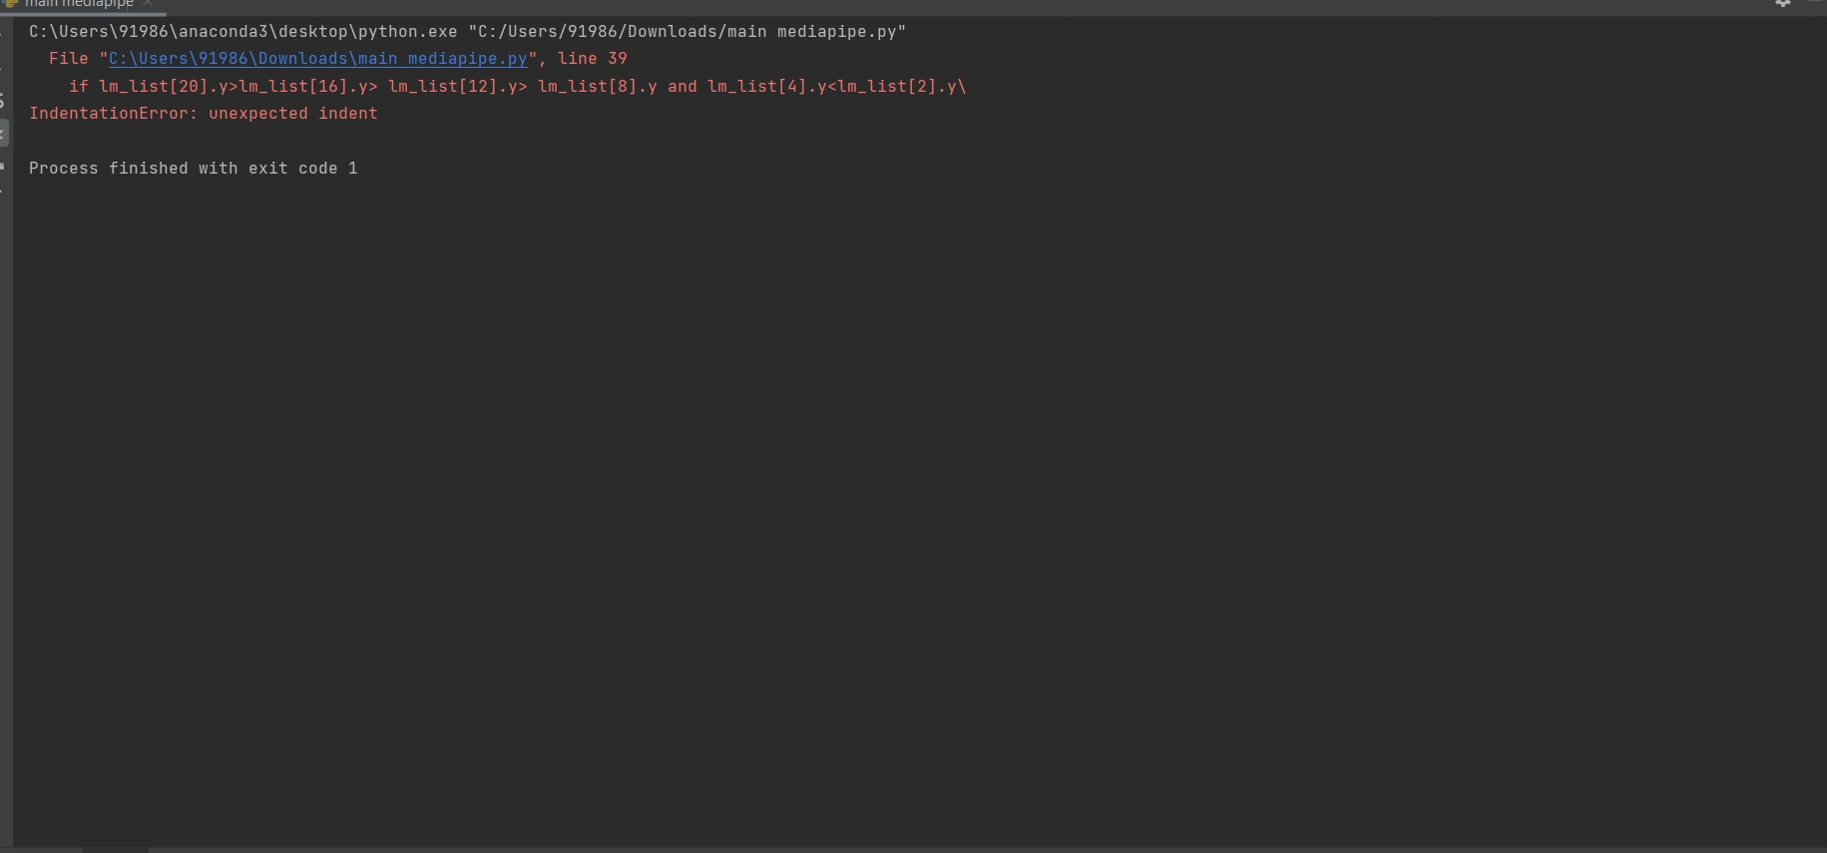
ERRORS FACED
INDENTATION ERROR(in approach 1)
This error occurs when you missed out adding tabs or spaces between lines of code.
So, we have resolved this error easily.

Slide 45
CAUSES OF INDENTATION ERROR
While programming you have placed an indentation in the wrong place. Since python follows strict guidelines when it comes to arranging the code, if you placed any indentation in the wrong place, the indentation error is mostly inevitable.
Sometimes in the midst of finishing a long program, we tend to miss out on indenting the compound statements such as for, while and if and this in most cases will lead to an indentation error.
If you forget to use user defined classes, then an indentation error will most likely pop up.

Slide 46
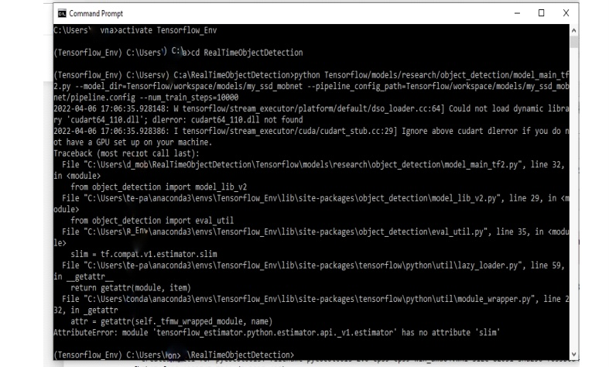
MAJOR ERRORS :In training part ( approach 2)
ATTRIBUTE ERROR
Attribute Error can be defined as an error that is raised when an attribute reference or assignment fails.
This error of attribute 'slim' was non- resolvable .

Slide 47
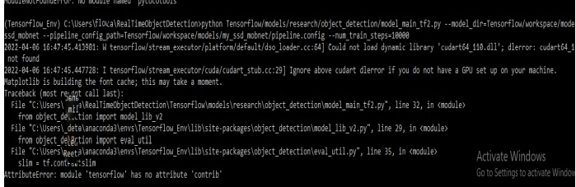
If the previous error resolves somehow then it leads to other Attribute error 'contrib’.

Slide 48
CONCLUSION
We have been succesfully able to recognise 16 signs by machine learning using OPENCV (to access webcam) ,mediapipe (to recognise hand landmarks) and playsound (to convert text to audio).
The project initially aimed at converting sign language to text but here we were able to go a step ahead by converting it to sound also.
For the approach 2 we have succesfully cloned repositories, collected images using our webcam, labelled them, generated Tf records and went on to the training part where we encountered multiple errors ; some of them we solved , for others we were stuck in a looped error

Slide 49
FUTURE SCOPES
This could be used by dumb and deaf people as a way of communication.
This method could be further used for object detection. It could be implemented to detect facial and gesture recognition.
It could be used in security checks at public places.
It could be further extended to two handed dynamic signs as well.

Slide 50
THANK YOU

